Slide 1




Introduction to R
Jennifer C Nascimento-Schulze
March 2023, Porto

Slide 2
What is R?
A computational language and an environment
Powerful tool for computational statistics and data visualisation (graphics) R can apply a wide number of statistical tests in your data set (linear and nonlinear modelling, classical statistical tests, time-series analysis, classification, clustering, …) and models can be visualised easily
It compiles and runs on UNIX platforms and similar systems (FreeBSD and Linux), Windows and MacOS
Developed based on statistical language S
Notes:
R is one of the most commonly used programming languages in data science.
It is a GNU project which is similar to the S language and environment which was developed at Bell Laboratories (formerly AT&T, now Lucent Technologies) by John Chambers and colleagues. R can be considered as a different implementation of S. There are some important differences, but much code written for S runs unaltered under R.
R provides a wide variety of statistical (linear and nonlinear modelling, classical statistical tests, time-series analysis, classification, clustering, …) and graphical techniques, and is highly extensible. The S language is often the vehicle of choice for research in statistical methodology, and R provides an Open Source route to participation in that activity.
One of R’s strengths is the ease with which well-designed publication-quality plots can be produced, including mathematical symbols and formulae where needed. Great care has been taken over the defaults for the minor design choices in graphics, but the user retains full control.
R is available as Free Software under the terms of the Free Software Foundation’s GNU General Public License in source code form. It compiles and runs on a wide variety of UNIX platforms and similar systems (including FreeBSD and Linux), Windows and MacOS.

Slide 3
Why ?
Relates to other computational languages
It’s free!
(GNU project)
Advanced statistical language
Produces high quality plots suitable for publication - all you need is a reference!
Platform independent (no need to modify your code)
Flexible tools – use your creativity and code
Vast community –Don’t be scared of the errors; google is your best friend!
You can contribute to develop packages etc..
Notes:
R is one of the most commonly used programming languages in data science.
It is a GNU project which is similar to the S language and environment which was developed at Bell Laboratories (formerly AT&T, now Lucent Technologies) by John Chambers and colleagues. R can be considered as a different implementation of S. There are some important differences, but much code written for S runs unaltered under R.
R provides a wide variety of statistical (linear and nonlinear modelling, classical statistical tests, time-series analysis, classification, clustering, …) and graphical techniques, and is highly extensible. The S language is often the vehicle of choice for research in statistical methodology, and R provides an Open Source route to participation in that activity.
One of R’s strengths is the ease with which well-designed publication-quality plots can be produced, including mathematical symbols and formulae where needed. Great care has been taken over the defaults for the minor design choices in graphics, but the user retains full control.
R is available as Free Software under the terms of the Free Software Foundation’s GNU General Public License in source code form. It compiles and runs on a wide variety of UNIX platforms and similar systems (including FreeBSD and Linux), Windows and MacOS.

Slide 4
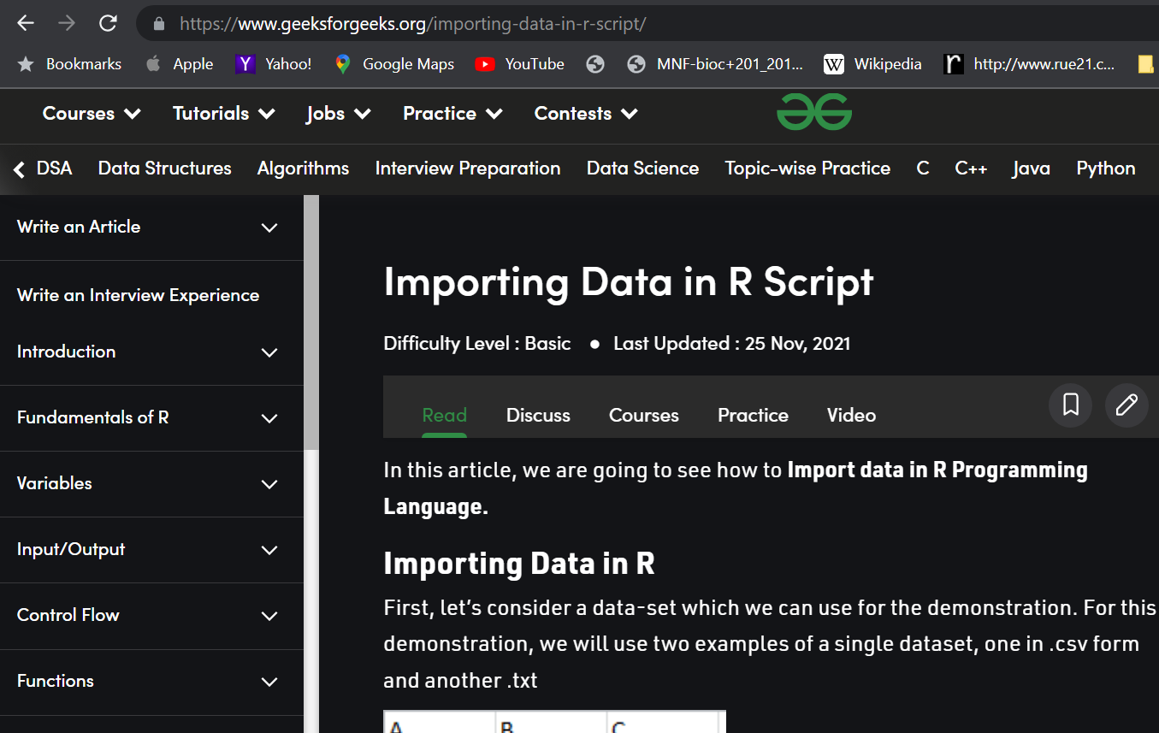

Slide 5
R console and R studio
R console = command line application
R studio – Intuitive user friendly interface for R
Notes:
R is one of the most commonly used programming languages in data science.
It is a GNU project which is similar to the S language and environment which was developed at Bell Laboratories (formerly AT&T, now Lucent Technologies) by John Chambers and colleagues. R can be considered as a different implementation of S. There are some important differences, but much code written for S runs unaltered under R.
R provides a wide variety of statistical (linear and nonlinear modelling, classical statistical tests, time-series analysis, classification, clustering, …) and graphical techniques, and is highly extensible. The S language is often the vehicle of choice for research in statistical methodology, and R provides an Open Source route to participation in that activity.
One of R’s strengths is the ease with which well-designed publication-quality plots can be produced, including mathematical symbols and formulae where needed. Great care has been taken over the defaults for the minor design choices in graphics, but the user retains full control.
R is available as Free Software under the terms of the Free Software Foundation’s GNU General Public License in source code form. It compiles and runs on a wide variety of UNIX platforms and similar systems (including FreeBSD and Linux), Windows and MacOS.

Slide 6
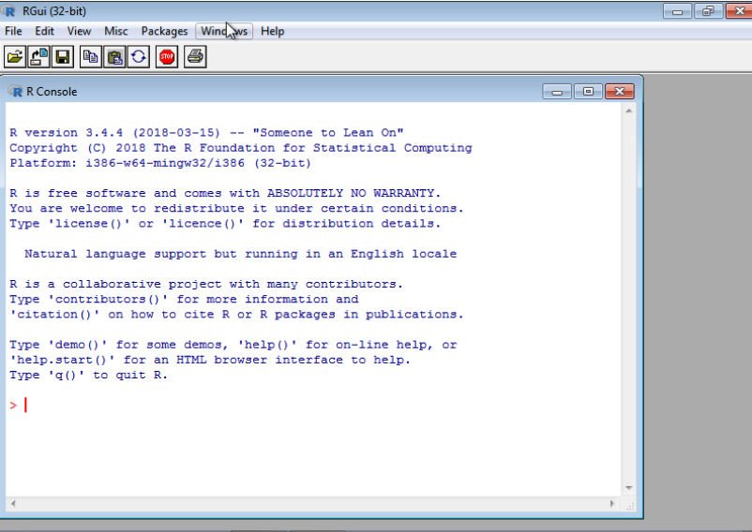
R console
Enter your command after the > prompt

Slide 7
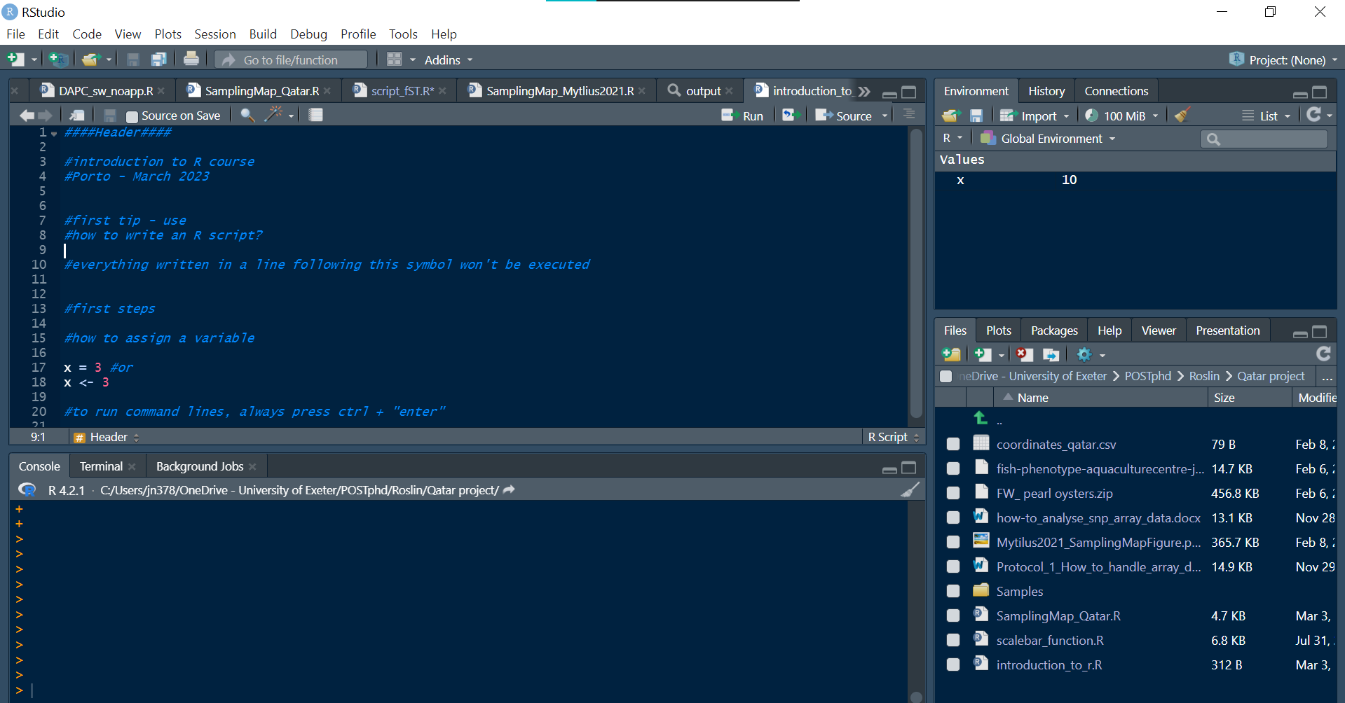
Rstudio
Your environment/
history
Script
Console
Multi task pane (output/ working directory)

Slide 8
Download R
Download R https://cran.r-project.org/bin/windows/base/
Download Rstudio https://www.rstudio.com/
Notes:
R is one of the most commonly used programming languages in data science.
It is a GNU project which is similar to the S language and environment which was developed at Bell Laboratories (formerly AT&T, now Lucent Technologies) by John Chambers and colleagues. R can be considered as a different implementation of S. There are some important differences, but much code written for S runs unaltered under R.
R provides a wide variety of statistical (linear and nonlinear modelling, classical statistical tests, time-series analysis, classification, clustering, …) and graphical techniques, and is highly extensible. The S language is often the vehicle of choice for research in statistical methodology, and R provides an Open Source route to participation in that activity.
One of R’s strengths is the ease with which well-designed publication-quality plots can be produced, including mathematical symbols and formulae where needed. Great care has been taken over the defaults for the minor design choices in graphics, but the user retains full control.
R is available as Free Software under the terms of the Free Software Foundation’s GNU General Public License in source code form. It compiles and runs on a wide variety of UNIX platforms and similar systems (including FreeBSD and Linux), Windows and MacOS.

Slide 9
Data types

Slide 10
Variables
Name given to a memory location - objects which store values in R
These variables can store: numbers, words, data matrices and tables
Creating a variable:
Notes:
Variables in R Programming
A variable is a name given to a memory location, which is used to store values in a computer program. Variables in R programming can be used to store numbers (real and complex), words, matrices, and even tables. R is a dynamically programmed language which means that unlike other programming languages, we do not have to declare the data type of a variable before we can use it in our program. For a variable to be valid, it should follow these rules
It should contain letters, numbers, and only dot or underscore characters.
It should not start with a number (eg:- 2iota)
It should not start with a dot followed by a number (eg:- .2iota)
It should not start with an underscore (eg:- _iota)
It should not be a reserved keyword.

Slide 11
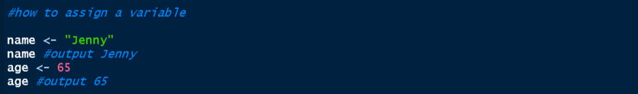
Variables
To create a variable (e.g. “name” and “age”) , you must assign it a value values are assign following the “<-”
You can multiple (*), add( +), substract (-), square root (sqrt()) … your variables
R can do loops

Slide 12
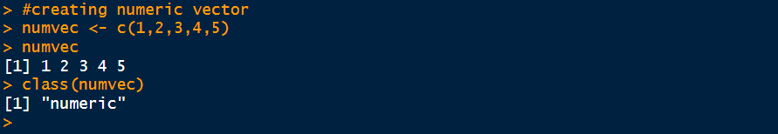
Data types - Vectors
Vectors consist on list of variables, those can be a collection of numbers, arithmetic expressions, logical values or character strings …
Vectors are normally created using function: c()
Numeric (variable with a decimal value assigned to it)

Slide 13
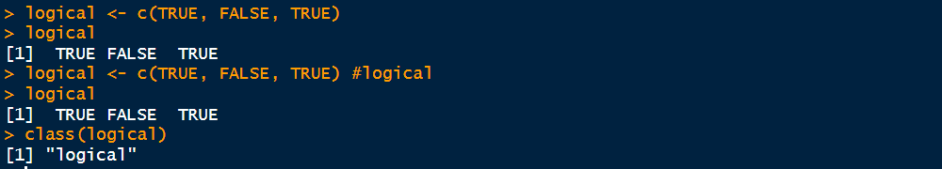
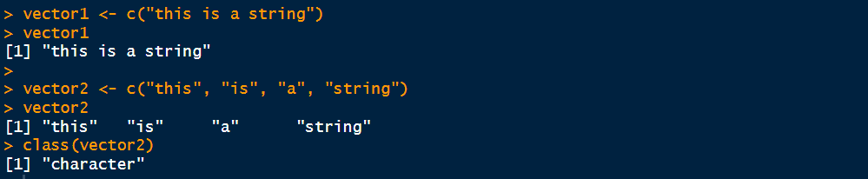
Data types - Vectors
Logical vectors
Character: vector representing string values (require quotations “ “)

Slide 14
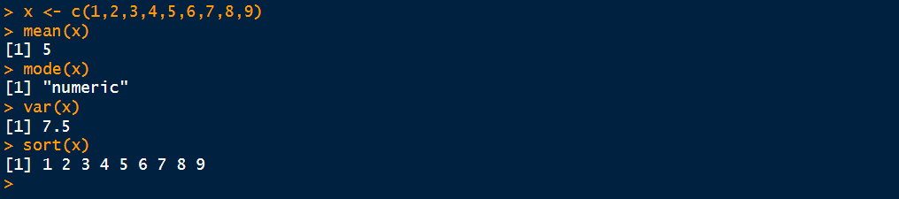
Data types - Vectors
Basic functions – calculate mean, variance and sort the data within a vector

Slide 15
Coding: Reminders and Tips
Notes:
R is one of the most commonly used programming languages in data science.
It is a GNU project which is similar to the S language and environment which was developed at Bell Laboratories (formerly AT&T, now Lucent Technologies) by John Chambers and colleagues. R can be considered as a different implementation of S. There are some important differences, but much code written for S runs unaltered under R.
R provides a wide variety of statistical (linear and nonlinear modelling, classical statistical tests, time-series analysis, classification, clustering, …) and graphical techniques, and is highly extensible. The S language is often the vehicle of choice for research in statistical methodology, and R provides an Open Source route to participation in that activity.
One of R’s strengths is the ease with which well-designed publication-quality plots can be produced, including mathematical symbols and formulae where needed. Great care has been taken over the defaults for the minor design choices in graphics, but the user retains full control.
R is available as Free Software under the terms of the Free Software Foundation’s GNU General Public License in source code form. It compiles and runs on a wide variety of UNIX platforms and similar systems (including FreeBSD and Linux), Windows and MacOS.

Slide 16
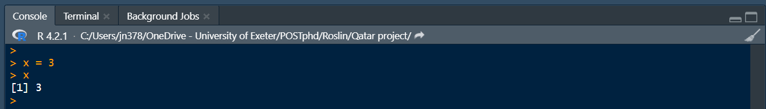
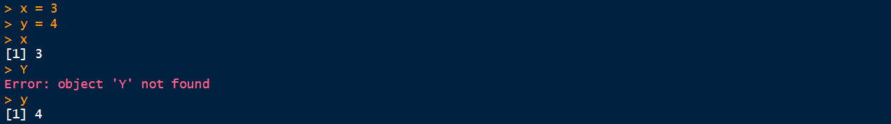
Code writing: Important reminders
R is ready for input when the “>” prompt is appearing in the console (CTRL + ENTER)
Case sensitive language
Does not deal well with spaces – never use spaces in file names or when naming a variable
help(function) - powerful tool to get a brief description of the function with examples

Slide 17
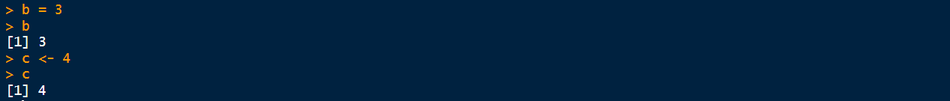
Important reminders
Values can be assigned with either “<-” or “=“
Name your variables with an easy/meaningful name – avoid long/uppercase complicated names – avoid mistakes & saves time – cannot star with numbers or underscore
Set working directory manually (Rstudio) or command line

Slide 18
Importing datasets
Notes:
R is one of the most commonly used programming languages in data science.
It is a GNU project which is similar to the S language and environment which was developed at Bell Laboratories (formerly AT&T, now Lucent Technologies) by John Chambers and colleagues. R can be considered as a different implementation of S. There are some important differences, but much code written for S runs unaltered under R.
R provides a wide variety of statistical (linear and nonlinear modelling, classical statistical tests, time-series analysis, classification, clustering, …) and graphical techniques, and is highly extensible. The S language is often the vehicle of choice for research in statistical methodology, and R provides an Open Source route to participation in that activity.
One of R’s strengths is the ease with which well-designed publication-quality plots can be produced, including mathematical symbols and formulae where needed. Great care has been taken over the defaults for the minor design choices in graphics, but the user retains full control.
R is available as Free Software under the terms of the Free Software Foundation’s GNU General Public License in source code form. It compiles and runs on a wide variety of UNIX platforms and similar systems (including FreeBSD and Linux), Windows and MacOS.

Slide 19
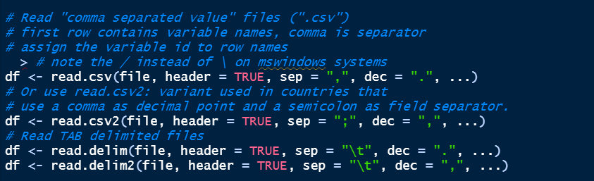
Importing datasets
Multiple data formats can be imported into R
Comma delimited files (csv) and tab delimited files

Slide 20
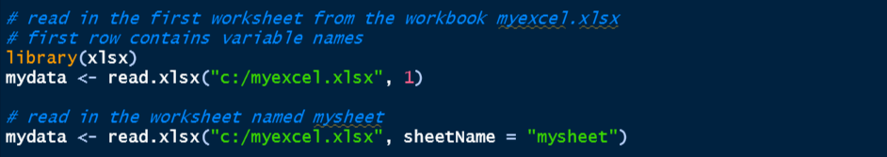
Importing datasets
Excel files

Slide 21
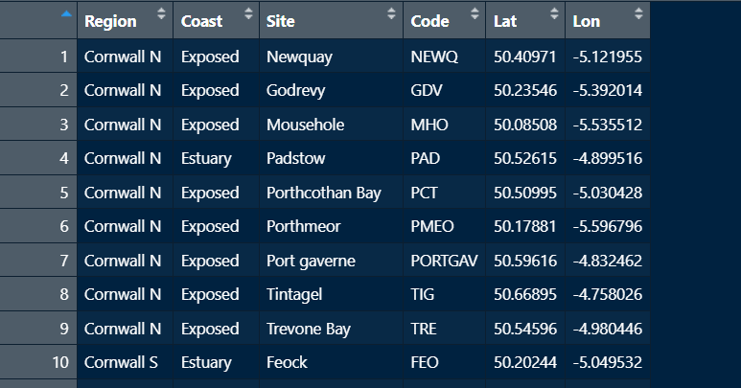
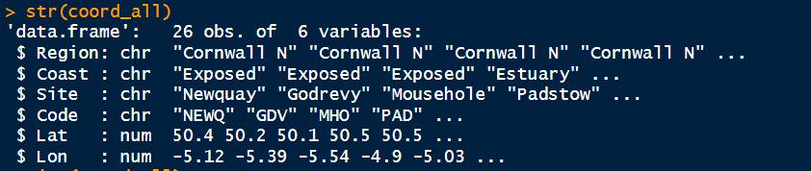
Checking data structure and changing data format
After importing your dataset, you can check the format of each of the variables in it
To change from character to numeric use command as.numeric e.g. coord_all$Region <- as.numeric(coord_all$Region)
You can also transform your variables into factors (as.factor) and character (as.character)
These transformation are important when applying statistical tests where you have to identify your sample info and the factors used in an experiment

Slide 22

Subsetting
Used to select and exclude variables and observations
Remove nonrelevant parts of your dataset or focus on specific sections of it

Slide 23
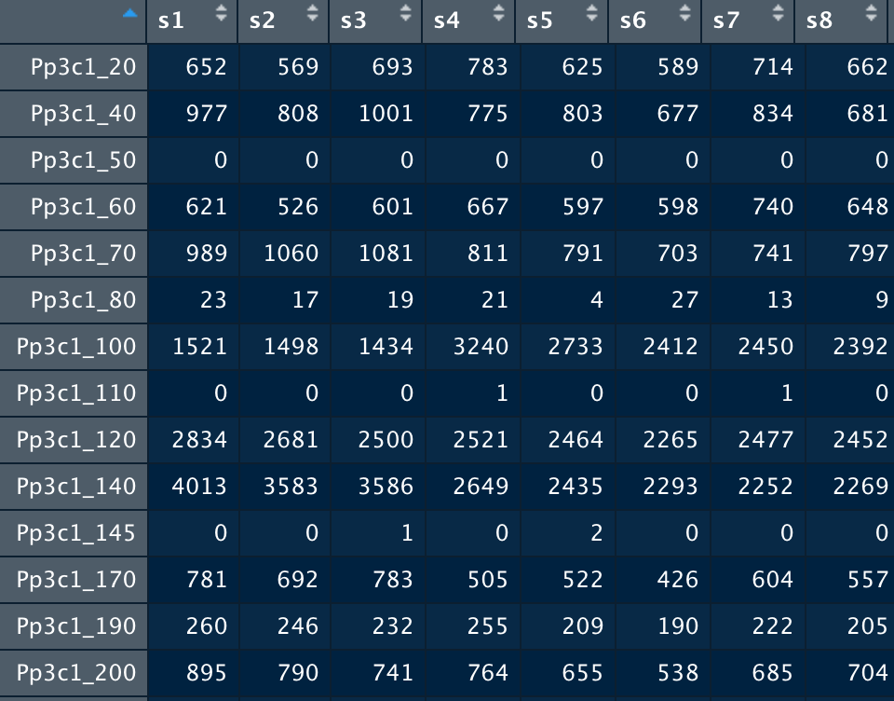
Subsetting - example
Data counts1 RNA expression (rows: 32,926) in different time points (columns: 33)

Slide 24
Subsetting - example
Select columns/rows from/to specific values : new_dataframe = old_dataframe[1:15, ] (selecting rows)
Select specific columns/rows in a random order by creating a vector: new_dataframe = old_dataframe[ ,c(1,2,3,10)] (selecting vector of columns)
Remove specific columns/rows by using the "-" sign: new_dataframe = old_dataframe[ ,c(-1,-2,-3,-10)] (selecting vector of columns)

Slide 25
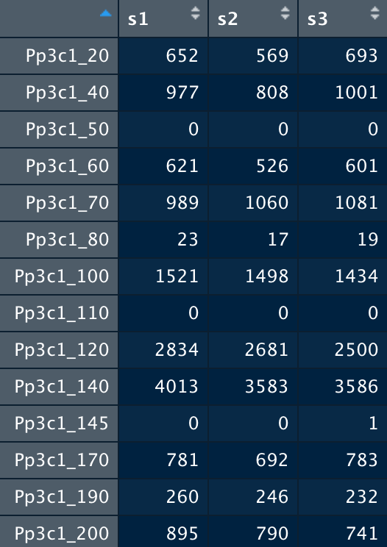
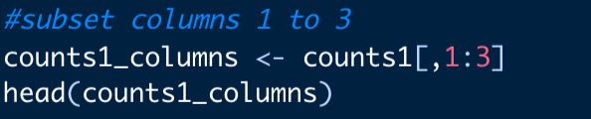
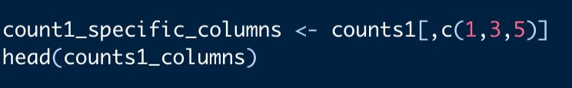
Subsetting - example
Output
Subset columns 1 to 3 in counts 1
Subset specific columns – creating a vector

Slide 26
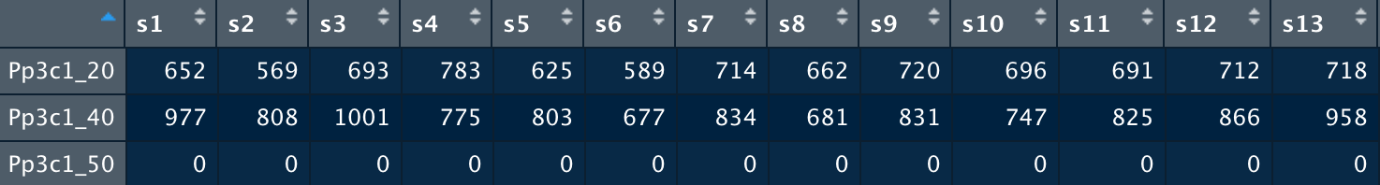
Subsetting - example
Subset columns 1 to 3 in counts 1
Same for rows
Output

Slide 27
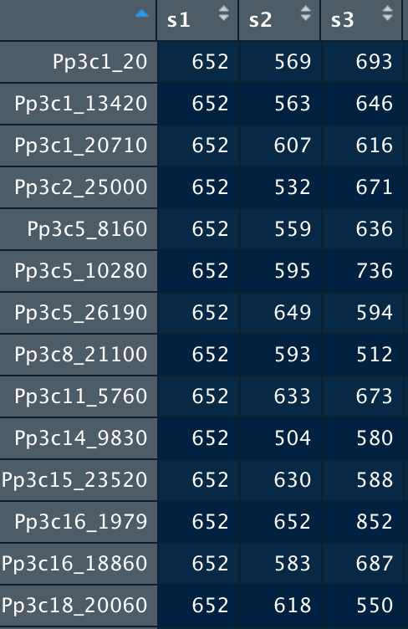
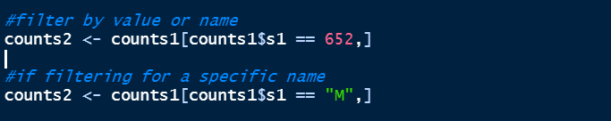
Subsetting - example
Subset by row/column value

Slide 28
Packages and libraries
Packages are a collection of R functions, formed by pre complied code and sample data (users can import the data to use as examples)
Different packages have different functions
xlxs imports excel files
dyplr imports a number of functions for subsetting datasets
ggplot2 main package for producing plots with numerous functions for enhancing aesthetics

Slide 29
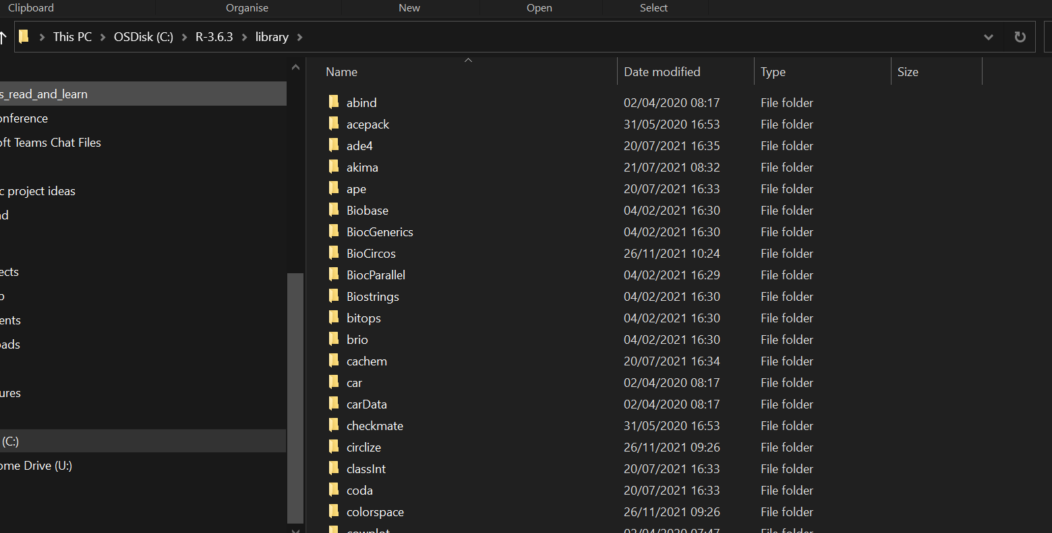
Packages and libraries
Libraries are the directories in which packages are installed, and stored, in your computer
My packages
. They are stored under a directory called "library" in the R environment. By default, R installs a set of packages during installation. More packages are added later, when they are needed for some specific purpose. When we start the R console, only the default packages are available by default. Other packages which are already installed have to be loaded explicitly to be used by the R program that is going to use them.

Slide 30


Installing and calling packages
To install packages use function (directly from CRAN network of ftp and servers for R codes and documentations)
install.packages(“yourpackage”)
To load your package, use function library(ggplot2)

Slide 31

Scripts
Scripts are a text file saved with an .R extension with the code containing the necessary commands for analysing your dataset
If you run commands directly in the console those will not be saved and you will need to repeat all the coding over again – avoid headaches and write a script!

Slide 32
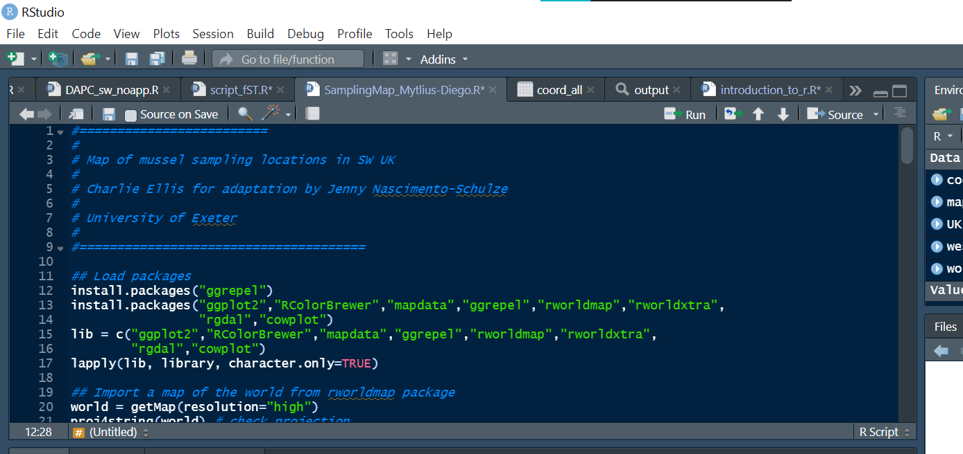
Scripts - Tips
Be organised
Leave yourself comments with the ‘#’ at any place in a line– they will help you in the future

Slide 33
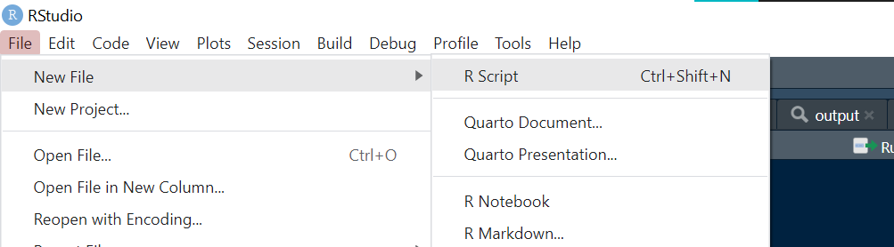
Scripts
Create a new script in Rstudio go click on the upper left side of window File>> New file>> R Script a blank page will open in the script window and you can start writing your commands

Slide 34
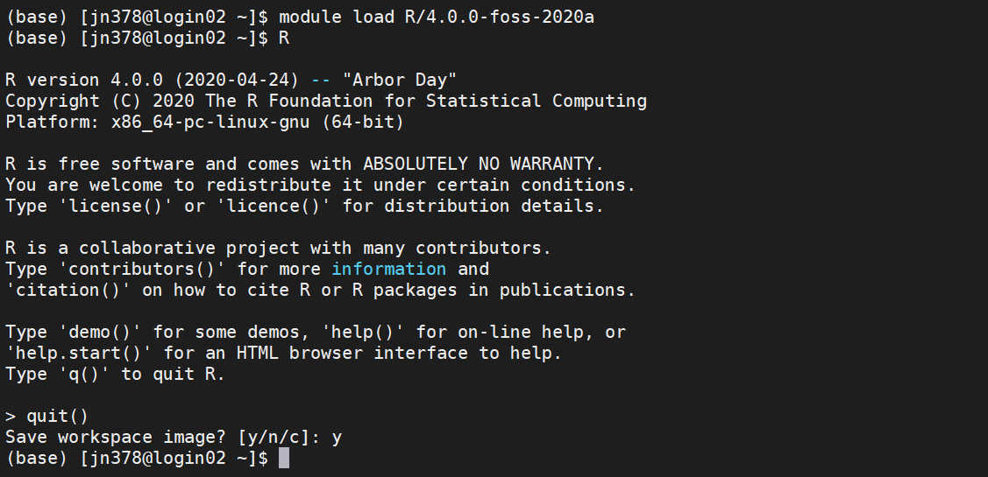
Call R from server

Slide 35
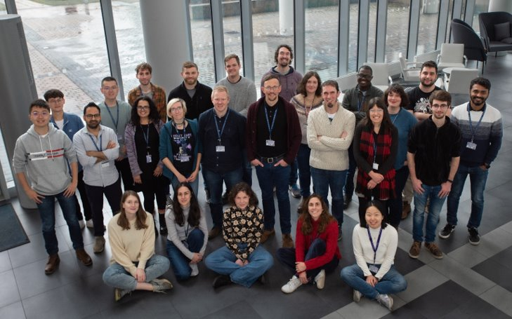

Thank you & have fun using R!

Slide 36
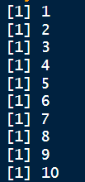
output
In this case, “()” defines the function and “{}” the expression

Slide 37
While entering and running your code at the R command line is effective and simple. This technique has its limitations. Each time you want to execute a set of commands, you have to re-enter them at the command line. Complex commands are potentially subject to typographical errors, necessitating that they be re-entered correctly. Repeating a set of operations requires re-entering the code stream. Fortunately, R and RStudio provide a method to mitigate these issues. R scripts are that solution.
A script is simply a text file containing a set of commands and comments. The script can be saved and used later to re-execute the saved commands. The script can also be edited so you can execute a modified version of the commands.
Creating an R script
It is easy to create a new script in RStudio. You can open a new empty script by clicking the New File icon in the upper left of the main RStudio toolbar. This icon looks like a white square with a white plus sign in a green circle. Clicking the icon opens the New File Menu. Click the R Script menu option and the script editor will open with an empty script.

